Slide 1

Speak fluently
Intermediate

Slide 2
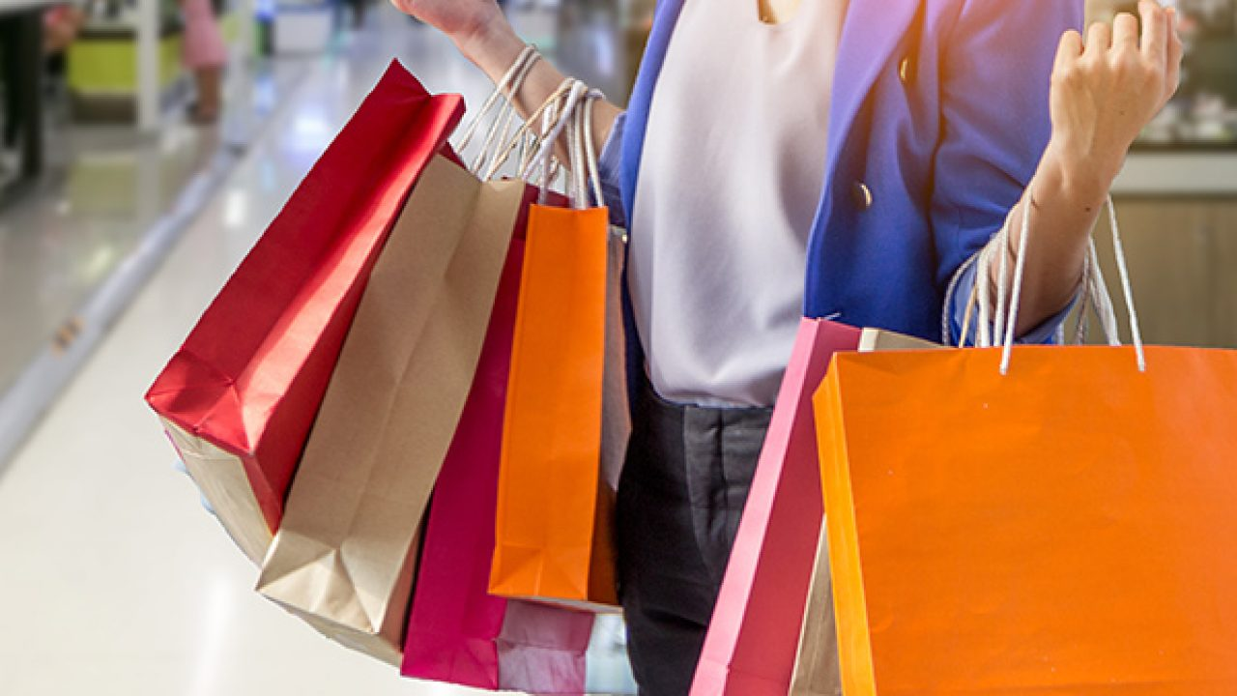
13. Shopping

Slide 3
13. Shopping
Do you like shopping? For what kinds of things?
Have you ever spent too much money on shopping? What did you buy? How did you feel afterwards?
How long do you usually shop? Do you try to get your shopping done as fast as possible?
Do you shop online? What kinds of things do you buy online? What would you rather buy in person?
Think about the most expensive thing you have ever bought. Was it worth what you paid for it?
Do you prefer to shop alone or with other people? What are the advantages and disadvantages of each?
Are you a bargain hunter? Do you get excited about sales and discounts? When are the best sales in your country?
Which do you prefer? Buying things for yourself or for other people?
If you were to open your own shop, what kinds of things would you like to sell?
Have you ever returned something to the shop you bought it from? Why did you return it? Did you get a refund?
Do you care where products are made? Do you prefer to buy things which are made in your own country? Why or why not?

Slide 4
13. Shopping
12- How do you feel about sales people following you and helping you when you shop?
13 What makes a pleasant shopping experience?
14- How do you feel about shopping at department stores or malls?
15- What is your favorite ecommerce site? Why?
16- Do you know anyone who is addicted to shopping? Are you addicted to shopping?
17- Do you enjoy shopping for other people?

Slide 5
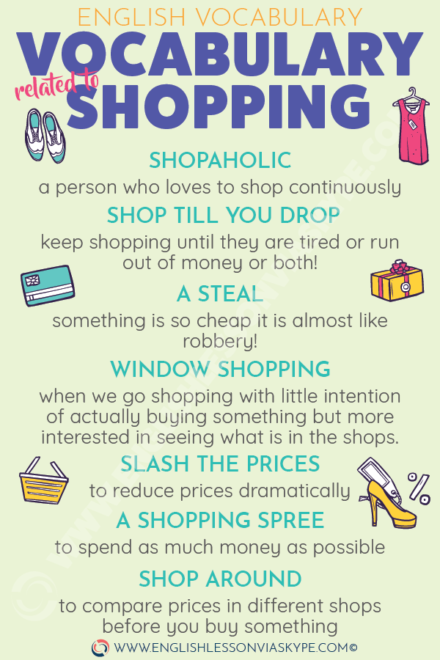
13. Shopping

Slide 6
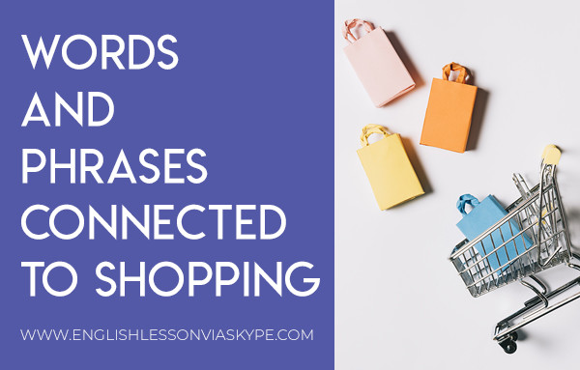
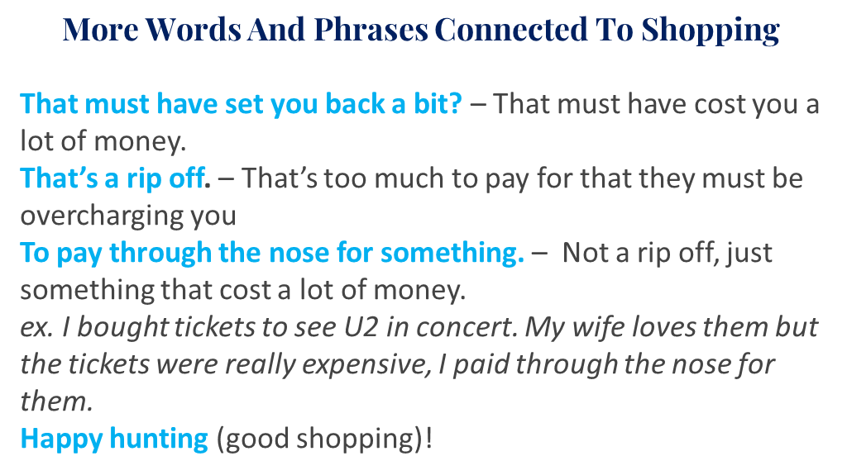
13. Shopping

Slide 7
13. Shopping
Most Used & Common Terms
Vocabulary | Explanation | Example
(Some) Change | Money exchange. | Have you got change to pay the swimming pool?
A banknote/a note/a bill | Paper money. | How many banknotes have you got?
A bargain | A good deal. | That’s a real bargain.
A bid | An offer in an auction. | What bids did you make?
A bill | An invoice. | I need the bill to be refunded.
A billboard | A large panel for advertising. | The billboards are huge.
A brand | A trademark. | Children love brands nowadays.
A carrier bag | A bag (usually plastic) supplied by shops. | Carrier bags are always provided.
A cashier | A person who operates cash register. | The cashier is so nice.
A catchphrase/a motto | A repeated phrase, slogan. | Do you know the brand’s catchphrase?

Slide 8
13. Shopping
Most Used & Common Terms
Vocabulary | Explanation | Example
A charge/to charge | A fee/To ask for money. | How much do you charge for this?
A check/cheque | An order for bank to pay. | I usually pay the doctor by check.
A client/customer | Someone who buys products. | Clients should always be satisfied with what you sell.
A coin | Metal money. | How many coins have you got?
A consumer | Someone who consumes, who buys. | How many customers will you target?
A corner shop | A small, local shop that sells a little of everything – it needn’t be on a corner. | He loves shopping in the corner shop.
A cost/to cost | A price. | The cost of the product is too high.
A counter | A flat, elevated surface. | Meet me at the counter.
A coupon | A discount voucher. | We love using coupons when we shop.
A deal | A transaction. | They got such a good deal yesterday.
A delivery/to deliver | An act of delivering. | The delivery was done on time.
A department | A division of organization. | Which department do you work for?
A department store | A large store that sells a range of items in different departments such as food and clothing. | Department stores are heaven.

Slide 9
13. Shopping
Most Used & Common Terms
Vocabulary | Explanation | Example
A design | A pattern, a styling. | He loves the new design of the product.
A discount store/pound shop | A shop where all the goods are sold at a discount. | My parents love going to discount stores.
A discount/to discount | A reduced price/to deduct from price. | They got a very good discount today.
A flea market | A market where antiques and second hand goods are sold. | It is so different to shop at the flea market.
A franchise | A business with a commercial licence. | Franchises are fun to shop in.
A fur trader | Person who deals in animal-fur products. | The fur trader did an excellent job with my coat.
A gift/present | Something you give to make the other person happy. | I love the gift he offered me.
A guarantee | A promise. | How long does the guarantee last?
A leaflet | A brochure. | Have you seen the company’s leaflet?
A loyalty card | a card issued by a shop to allow customers to save money on the basis of what they spend. | She has all the loyalty cards of her favorite shops.
A mall (US)/shopping centre (GB) | Place where many shops are gathered. | I love shopping in malls.
A market study | a study that analyzes market demand for a particular product or service. | Market studies are capital in advertising.
A must-have product | A product that is very popular that a lot of people want to have. | This bag is a must-have product.
A poll | A survey. | According to the poll, more and more clients shop there.
A purchase/To purchase | Something you buy/To buy. | What is this purchase I can see on your account?
A receipt | A proof of payment. | Did you get the receipt?

Slide 10
13. Shopping
Idioms:
window shopping : to just look in the window of the shop and you don’t buy anything.
a rip-off: a thing that costs way more than it should
shop till you drop: to shop for a long time till you get exhausted.
retail therapy: to shop to make yourself feel better
bargain hunting: to actively look for good deals on things that you shop for
shoplift : to steal from a store
fit like a glove: to fit perfectly
like a bull in a China shop: to act recklessly and destroy everything in a shop
A shopping spree : a short period of time when a person buys lots of things
pay through the nose: you pay a lot of money usually more than the fair price.

